Slide 1

Increased Calcite Nucleation (ICN) to Prevent Scaling in Boilers
Researching an Alternative to Water Softeners
A. Alnashwan, M. Alsahali, K. De Silva, F. Yu
Northern Arizona University
CENE 486C
Client: Jon Heitzinger, NAU Utilities Manager
Technical Advisor- Dr. Terry E. Baxter
Grading Instructor- Dr. Dianne McDonnell
12-7-2018

Slide 2
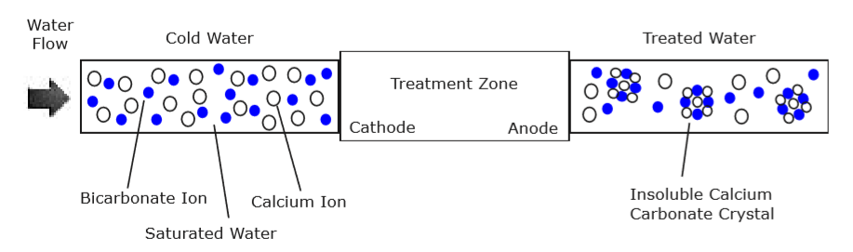
Introduction
Testing an Increased Calcite Nucleation (ICN) water conditioner under boiler conditions of the South boiler plant at NAU
Figure 01: The Process Uses Dissimilar Metals to Prevent Scale Growth Sites and to Form Aragonite Crystals [1]

Slide 3
Introduction
Table 01: Predictions based on the Manufacturer claims that the EWS ICN reduces scaling by forming less sticky aragonite crystals and not the stickier calcite crystals
Parameter | Post Boiling Groundwater | Post Boiling Conditioned ICN Water
Total Suspended Solids (TSS) Suspended Solids nucleate to form CaCO₃precipitate (Calcite or Aragonite) | TSS in the effluent decreases Calcite sticks to Vessel and does not stay in the water | TSS in the effluent will increase Aragonite will not stick to vessel and stays in the water
Total Alkalinity and Hardness as CaCO₃ | Alkalinity and Hardness in the effluent decrease Hardness and Alkalinity will be removed from the water as a precipitate | Alkalinity and Hardness in the effluent decrease Hardness and Alkalinity will be removed from the water as a precipitate
Scanning Electron Microscope (SEM) Images the polymorphs of Calcium Carbonate (CaCO₃) | Calcite crystals from in the scale Calcite formation is favored in freshwater | Aragonite crystal from in the scale Zinc in the conditioner changes the crystal structure

Slide 4
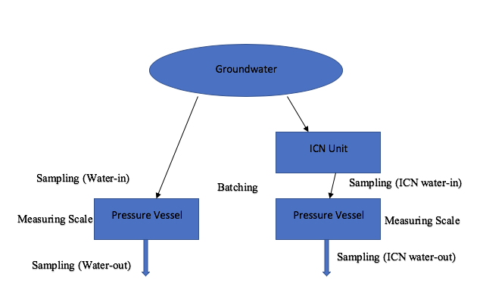
Design Set-up
Groundwater samples: Collected from an unconditioned residential water source
ICN samples: Collected from an ICN conditioned residential water source
Figure 02: Testing Design Set-Up-Created by Ahmed Alnashwan

Slide 5
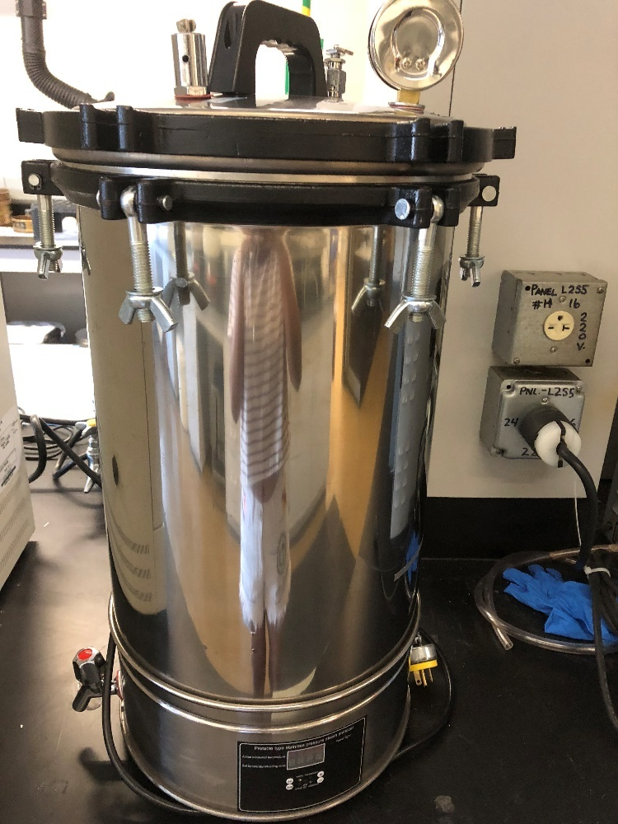
Optimized Procedure
Step 1: Simulating the boiler conditions using the pressure vessel
  250 F and 160 PSI [2]
Step 2: Collect GW and ICN samples for batching
Step 3: Testing of the water before getting batched
Step 4: Batching of GW and ICN
  6 batches in total
  5 gallons (~19L) of water per 6 hrs.
Step 5: Testing of the water after getting batched
Step 6: Scale measurement
  Using a weighing scale (Accuracy=0.1g)
Step 7: De-scale the pressure vessel
  Using Vinegar
Figure 03: Pressure Vessel-Taken by: Kalani De Silva

Slide 6
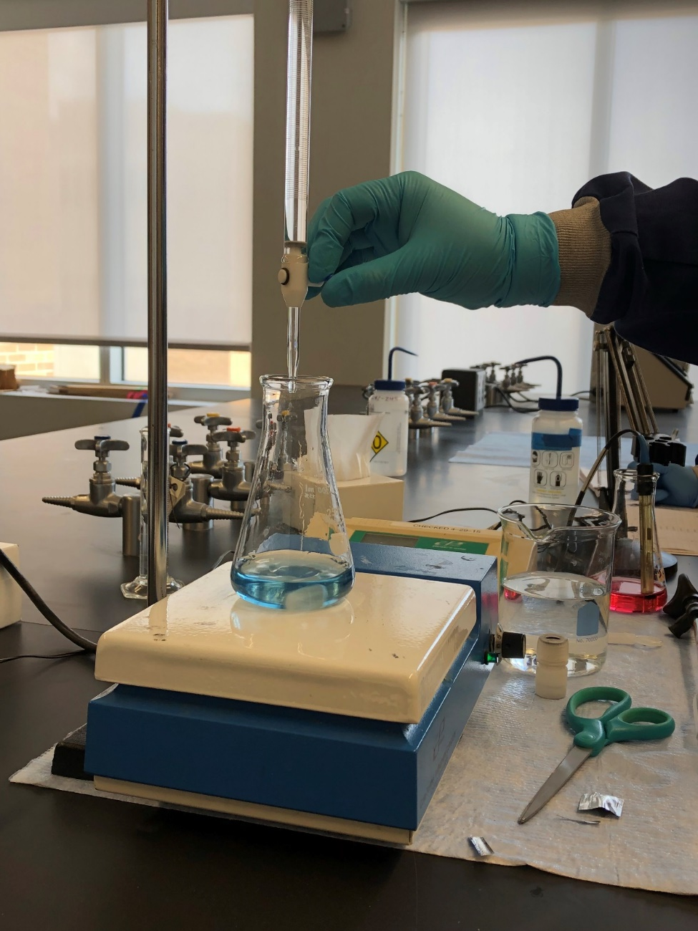
Methods for Water Quality Testing
  Hardness test: HACH Method 8226 [3]
      Testing for total hardness, calcium hardness and magnesium hardness
  Alkalinity test : HACH method 8203 [3]
      Total alkalinity
  TS test: Standard Method 2540 C&D [3]
      Total Suspended Solid (TSS)
Figure 04:Conducting Hardness Tests-Taken by Kalani De Silva

Slide 7
Water Quality Results
Table 02: Water Quality Parameters: GW VS ICN
 | Total Hardness |  | Total Alkalinity |  | TSS
 | Before Heat | After Heat | Before Heat | After Heat | Before Heat | After Heat
GW | 150 +/- 0.0 | 73.3 +/- 5.2 | 260 +/-4.1 | 140 +/- 0.0 | 26.7 +/- 1.2 | 35 +/- 9.4
ICN | 150 +/-0.0 | 73.4 +/- 8.2 | 240 +/- 0.1 | 146.7 +/- 10.3 | 40 +/-1.0 | 60 +/- 22.3
% Difference | 0 | 0.13% | 7.7% | 4.8% | 50% | 71%
Hardness Standard: 0-60 mg/L Soft
60-120 mg/L Moderately hard
120-180 mg/L Hard
        >180 Very Hard

Slide 8
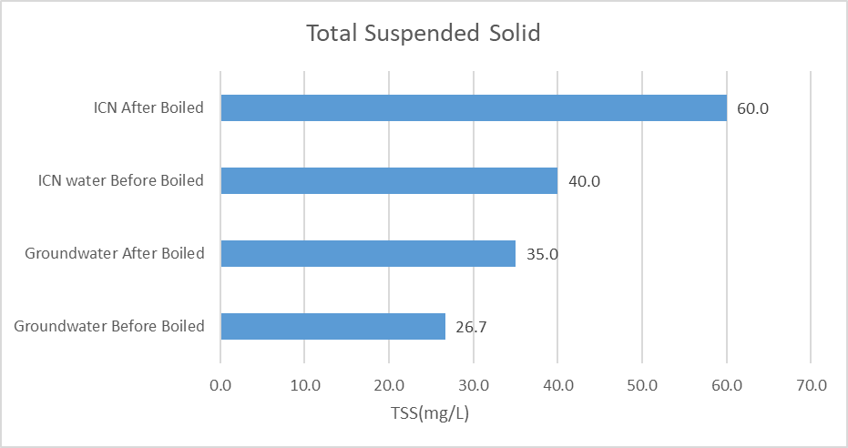
Water Quality Results
Figure 05: Comparison of TSS Between GW and ICN Before and after Boiling
Table 03: Percentage of TSS increase
 | Groundwater After Heat | ICN Water After Heat
Percentage Increase | 131.3% | 225.0%

Slide 9
Scanning Electron Microscopy Images of GW ICN Water Samples

Slide 10
Figure 06a: GW Sample
Figure 06b: ICN Sample
Filter: Nitro-Cellulose filter with a pore diameter of 0.22
Volume: 100 mL of sample
No crystals found

Slide 11
Scanning Electron Microscopy Images of GW ICN Scale Samples

Slide 12
Figure 08a: GW Scale Sample- Calcite
Figure 08b: ICN Scale Sample- Aragonite
Calcite formations- Cubic like
Aragonite Formations- Needle like

Slide 13
Figure 09a: GW Scale Sample- Calcite
Figure 09a: ICN Scale Sample- Aragonite
The needle like structure makes the aragonite crystals less sticky

Slide 14
Figure 10a: GW Scale Sample- Calcite
Figure 10b: ICN Scale Sample- Aragonite

Slide 15
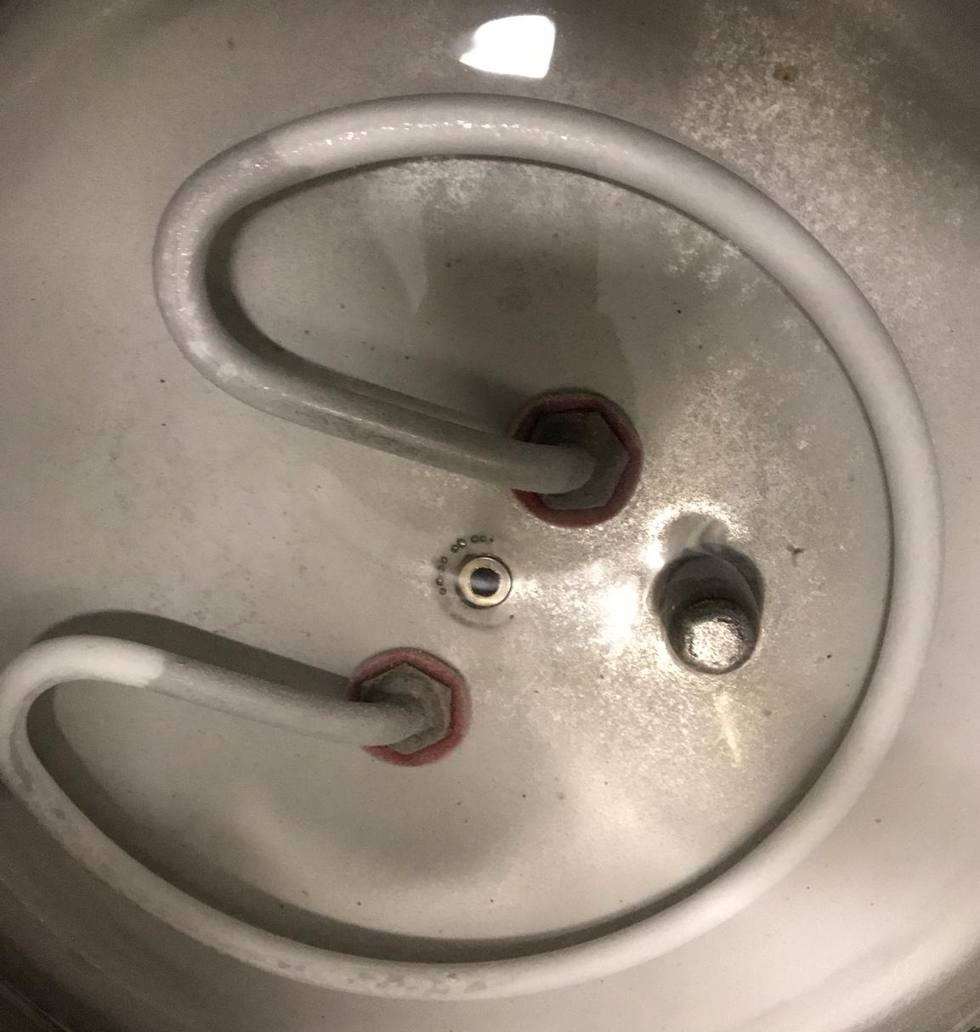
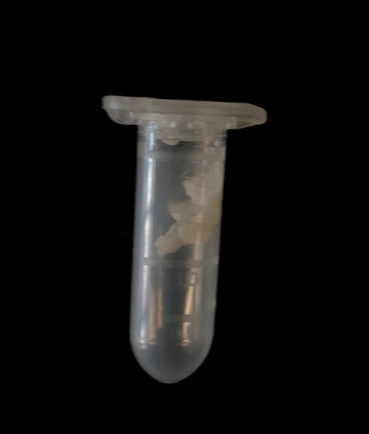
Determination of Scale Build Up
Table 04: Accumulated Scale from the Batching of GW and ICN Water Samples
 | GW | ICN
Initial Weight of the Vessel (g) | 10503.3 | 10507.3
Final Weight of the Vessel (g) | 10513.4 | 10510.6
Amount of Scale Build Up (g) | 10.1 | 3.3
Figure 12: Scale Scraped Down from Vessel
Figure 11: Scale Build Up on the Vessel After Six Batches

Slide 16
Summary of Results
Table 05: Summary of results explaining the proved predictions
Parameter | Post Boiling Groundwater | Post Boiling Conditioned ICN Water
Total Suspended Solids (TSS) Suspended Solids nucleate to form CaCO₃precipitate (Calcite or Aragonite) | TSS in the effluent decreases Calcite sticks to Vessel and does not stay in the water | TSS in the effluent will increase Aragonite will not stick to vessel and stays in the water
Total Alkalinity and Hardness as CaCO₃ | Alkalinity and Hardness in the effluent decrease Hardness and Alkalinity will be removed from the water as a precipitate | Alkalinity and Hardness in the effluent decrease Hardness and Alkalinity will be removed from the water as a precipitate
Scanning Electron Microscope (SEM) Images the polymorphs of Calcium Carbonate (CaCO₃) | Calcite crystals from in the scale Calcite formation is favored in freshwater | Aragonite crystal from in the scale ICN conditioner changes the crystal structure

Slide 17
Discussion
ICN does not prevent scale build up completely
  67% less scale formed compared to GW
Aragonite can revert back to calcite over time [10]
Several variables that can alter the results: does excess magnesium or zinc inhibit or decrease the likelihood of forming a precipitate
More research needs to be conducted to compare the ICN data with other alternative softener technologies to verify its efficiency

Slide 18
Project Schedule
 | Projected |  | Actual
Task Number and Name | Start Date | Finish Date | Start Date | Finish Date
1.0 Setting up station and apparatus | 5/30/18 | 6/12/18 | 7/31/18 | 9/01/18
1.1 Obtain the Unit | 5/30/18 | 6/4/18 | 7/31/18 | 8/13/18
1.2 Set up the station and optimization of the procedures | 6/4/18 | 6/12/18 | 8/15/18 | 9/01/18
2.0 Lab testing | 6/12/18 | 10/31/18 | 9/7/18 | 11/15/18
2.1 Batching of Groundwater: | 6/13/18 | 8/31/18 | 9/7/18 | 10/20/18
2.1.1 Hardness test | 6/13/18 | 8/31/18 | 9/7/18 | 10/20/18
2.1.2 Alkalinity test | 6/13/18 | 8/31/18 | 9/7/18 | 10/20/18
2.1.3 TS test | 6/13/18 | 8/31/18 | 9/7/18 | 10/20/18
2.1.4 Scale formation | 6/13/18 | 8/31/18 | 9/7/18 | 10/20/18
2.1.5 SEM tests | 6/13/18 | 8/31/18 | 10/20/18 | 10/22/18
2.2 Batching of ICN water: | 8/31/18 | 10/31/18 | 10/25/18 | 11/10/18
2.2.1 Hardness test | 8/31/18 | 10/31/18 | 10/25/18 | 11/10/18
2.2.2 Alkalinity test | 8/31/18 | 10/31/18 | 10/25/18 | 11/10/18
2.2.3 TS test | 8/31/18 | 10/31/18 | 10/25/18 | 11/10/18
2.2.4 SEM tests | 8/31/18 | 10/31/18 | 11/11/18 | 11/15/18
3.0 Analysis | 10/1/18 | 11/20/18 | 11/16/18 | 12/01/18
4.0 Deliverables | 9/20/18 | 12/20/18 | 9/20/18 | 12/20/18
4.1 30% Report | 9/20/18 | 9/20/18 | 9/20/18 | 9/20/18
4.2 60% Report | 10/6/18 | 10/25/18 | 10/6/18 | 10/25/18
4.3 90% website | 11/15/18 | 12/2/18 | 11/15/18 | 12/2/18
4.4 Final Report | 11/20/18 | 12/4/18 | 11/20/18 | 12/4/18
4.5 Final Presentation | 11/20/18 | 12/4/18 | 11/20/18 | 12/4/18
5.0 Project Management | 5/30/18 | 12/7/18 | 7/15/18 | 12/7/18
Table 06: Project Schedule: Predicted and Actual

Slide 19
Cost of Materials
Table 07a: Projected Material/Equipment Costs
Table 07b: Actual Projected Material/Equipment Costs
Materials | Quantity | Unit Cost $ | Total Cost $
ICN unit | 1 | 600 | 600
PVC pipes | 3 | 7 | 21
Pressure Vessel | 2 | 1050 | 2100
Sampling Containers | 12 | 13 | 156
Hose | 2 | 11 | 22
Bucket 5 gal | 1 | 6 | 6
Flow Meter | 1 | 45 | 45
Total materials cost |  |  | 2950
Materials | Quantity | Unit Cost $ | Total Cost $
Pressure Vessel | 1 | 800 | 800.0
Vinegar | 6 | 5 | 30.0
SEM Tests | 5 | 40 | 200.0
Total materials cost |  |  | 1030.0

Slide 20
Cost of Engineering Services
Table 08a: Projected Labor Costs and the Total Billing Cost of Engineering Services
Table 08b: Actual Labor Costs and the Total Billing Cost of Engineering Services
Personnel | Total Hours | Rate $/hr | Total Cost $
SENG | 100 | 255 | 25500
JENG | 248 | 175 | 43400
LT | 208 | 103 | 21424
RA | 150 | 135 | 20790
Total labor cost |  |  | 111,114
Total engineering billing cost |  |  | 114,064
Personnel | Total Hours | Rate $/hr | Total Cost $
SENG | 133 | 255 | 33915
JENG | 283 | 175 | 49525
LT | 432 | 103 | 44496
RA | 93 | 135 | 12555
Total labor cost |  |  | 140,491
Total engineering billing cost |  |  | 141,521

Slide 21
References
[1] D. McDonnell, “EWS, Inc. Physical Conditioning Discussion, Documentation and Position Papers”, Personnel Communications-Email, 2018.
[2]J. Heitzinger, E. Vaughan, “NAU chiller/boiler information”, Personnel Communications-Email, 2018.
[3]S. Lower, ‘Hard water and Water Softening,’Dept. of Chemistry, 2018.
[4]P. Fox, M. Wiest, T. Thomure, W. Lee, "Evaluation of Alternatives to Domestic Ion Exchange," WateReuse Research Foundation, Tempe, AZ, Rep. 01, 2011.
[5]HACH, HACH Water Analysis Handbook, Loveland, CO, U.S.A., HACH Company, 2003.
[6]"National Field Manual," USGS , 2006, pp. 10-130.
[7]W. S. Miller, "Understanding Ion-Exchange for water treatment system," GE water and process Technologies, vol. 35, no. 8, pp. 149-153, 2018.
[8]M. K. Ahn, C. Han, "Technologies for the Removal of Water Hardness and Scaling Prevention," Journal of Energy Engineering, vol. 26, no. 2, pp. 73-79, 2017
[9]“South Heating and Cooling Plant,” Northern Arizona University, Internet: http://library.nau.edu/speccoll/exhibits/louies_legacy/southheating.html [Accessed: 11-Feb-2018]
[10] A. Alden, “Calcite vs Aragonite”, 2017, Internet: https://www.thoughtco.com/calcite-vs-aragonite-1440962

